Slide 1
Deliverable 2 “Visualization”:
What are you trying to tell? Visualize how different features impact the popularity of a song across decades
First chart: Listing of all the measured features and indicate their relative importance
Second Chart: “Trends over the decades”: bar chart of the number of popular songs per decade with to trend lines showing the average score for the popular songs compared to average score for non popular songs.
Summary Charts: Number of popular songs with percent of total songs, average score of the four most important features with percent of max.
Dashboard interaction: Users selects the feature in the first chart and the second chart will change to that feature with its trend lines for that feature.
Dashboard interaction: User can select the decade bar in the second chart and the summary information for that decade will appear in the summary section.
This dashboard will be created using an excel file with Tableau.

Slide 2
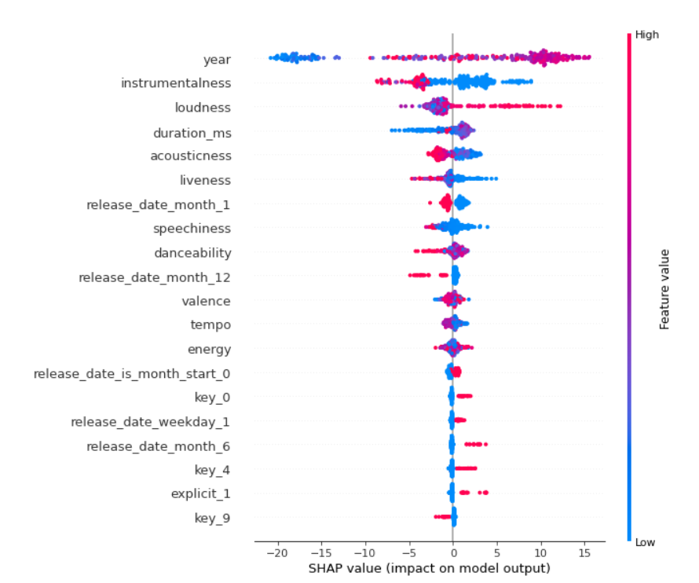
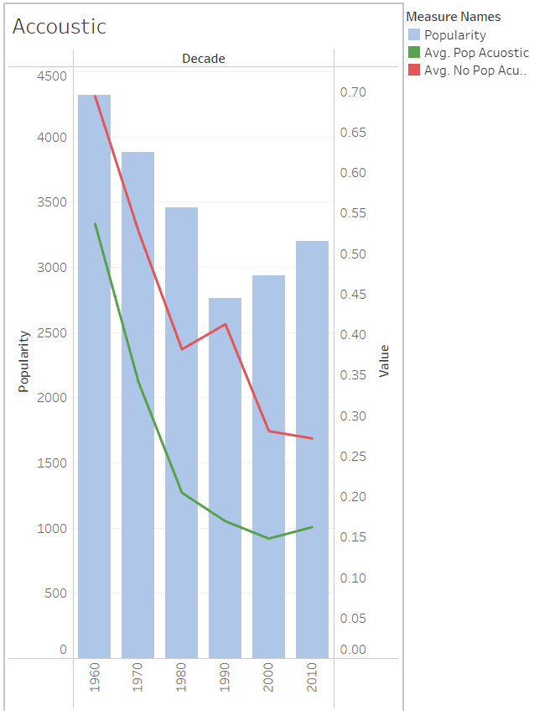
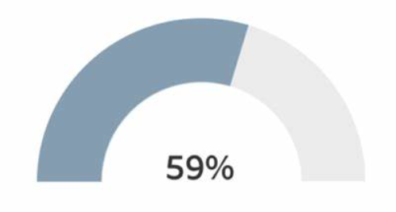
Features by Significance
Trends Over the Decades
Summary by Decade
4,321
Number Songs
.5306
i
.5306
Acoustics avg
Danceability avg
.6552
.6552
Energy avg
Instrumentality avg

